Slide 1
OCEAn: A Web Application for Object-Centric Emission Analysis Using Process Mining
Master Thesis – Final presentation
Raimund Hensen

Slide 2
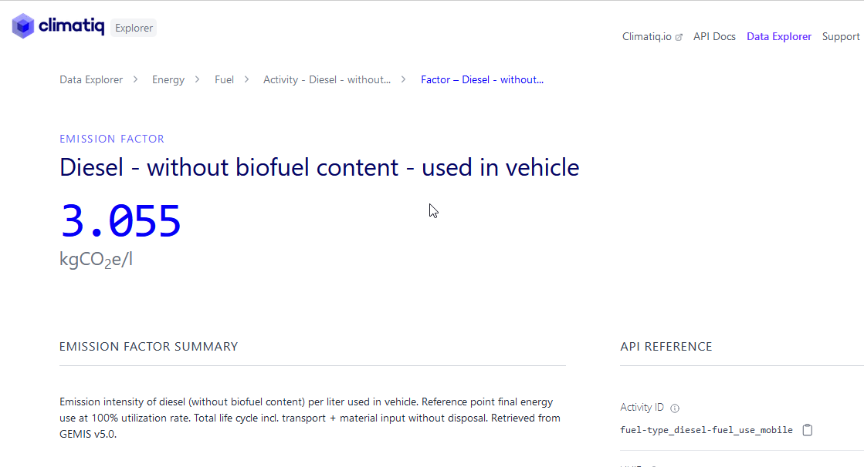

Example Process: Pallet Logistics
Emission insights from:
Average/total emissions per activity
Emissions along object‘s lifecycle
(target objects: items)
Problem:
Event log does not contain emission data
Order
?
Item
inspect
consumption
inspect
distance
50 km
receive
order
get item
12 L/100km
Vehicle
load
deliver
deliver
20 km
Pallet
Screenshot: climatiq / GEMIS (https://www.climatiq.io/data/emission-factor/d56128ea-76e5-4a31-a6fe-b5e1ed855e52, accessed Oct 8th, 2024)

Slide 3



Method Overview
Extended OCEL
Phase 1
Phase 2
containing
Emission Estimation
Define emission rules
Compute emissions based on data from OCEL
Emission Allocation
Aggregate per event
Allocate to objects
Event Emissions
Total event emissions
or
use
E2O Emissions
Object
emissions
OCEL
Web App for …
practical application
supporting research on OCPM for sustainability

Slide 4
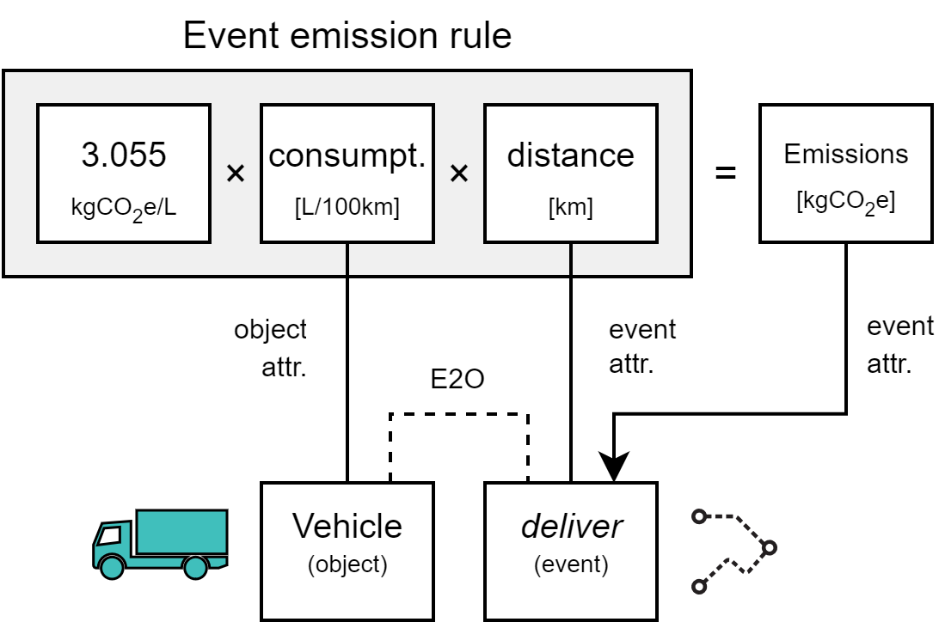
Emission Rules
Logistics – event-level
Activity: deliver
Proportional to: Fuel volume [L]
OCEL Attributes:
Fuel consumption [L/100km]:
object attr. of Vehicle
Distance [km]:
event attr. of deliver
Multiply with emission factor
[4]
[4] “Emission intensity of diesel (without biofuel content) per liter used in vehicle” – GEMIS (https://www.climatiq.io/data/emission-factor/d56128ea-76e5-4a31-a6fe-b5e1ed855e52)

Slide 5
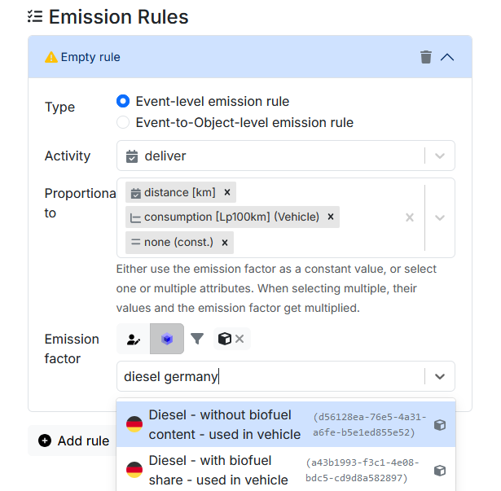



Method Overview – (1) Emission Estimation
Phase 1: Emission Estimation
Phase 2
EMISSION RULE
Emission
Allocation
Event Emissions
Total event emissions
Total event emissions
Activity
EMISSION
FACTOR
Object type
import
Ev. attributes
E2O Emissions
Object
emissions
Object
emissions
OCEL
Obj. attributes
define
export
select
access
sOCEL
Screenshot: climatiq / GEMIS (https://www.climatiq.io/data/emission-factor/d56128ea-76e5-4a31-a6fe-b5e1ed855e52, accessed Oct 8th, 2024)

Slide 6




Output Phase 1
Rule A
Activity: deliver
event 1
deliver
Rule B
Activity: deliver
event 2
deliver
Rule C
Activity: inspect
event 3
inspect
event 4
load

Slide 7
Method Overview – (1) Emission Estimation
Method Overview – (2) Emission Allocation
Phase 1
Phase 2
Emission
Estimation
Emission
Estimation
Emission
Allocation
Emission
Allocation
Event Emissions
Total event emissions
Total event emissions
import
E2O Emissions
Object
emissions
Object
emissions
OCEL
export
sOCEL

Slide 8

Method Overview – (2) Emission Allocation
Phase 1
Phase 2: Emission Allocation
Emission
Estimation
Event Emissions
Total event emissions
Aggregate per event
import
E2O Emissions
Object
emissions
OCEL
export
extended OCEL

Slide 9
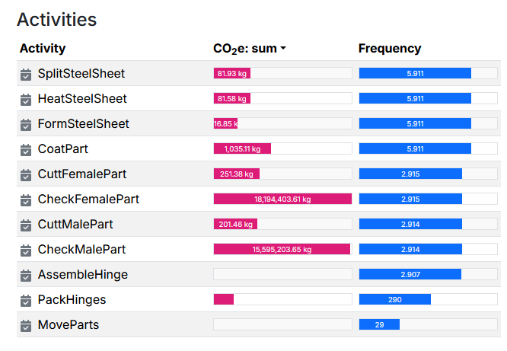
Event/Activity Perspective
Aggregate emissions per event
Next:
Integrate into OCEL as event attribute
Visualize average/total emissions per activity

Slide 10
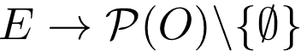
Method Overview – (2) Emission Allocation
Phase 1
Phase 2: Emission Allocation
Emission
Estimation
Event Emissions
Total event emissions
Aggregate per event
import
E2O Emissions
ALLOCATION RULE
Object
emissions
OCEL
export
select
extended OCEL

Slide 11
Object Perspective
event1
event2
Compute emissions per object
Input: total event emissions
Select set of target objects (here: items)
Apply allocation rule:
Assigns set of targets to each event
Distribute event emissions evenly among these target objects
Compute sum per object
order
1
pallet
2
item
2
E2O relations
3 kgCO2e
5 kgCO2e
Output phase 2a
Allocation
item
1
item
2
Targets
5.5 kg
CO2e
2.5 kg
CO2e
from ev1
from ev2
from ev2
Object
emissions
1/2
1/2
[2] C Ortmeier et al.: Framework for the integration of Process Mining into Life Cycle Assessment. In: Procedia CIRP, 98:163-168, 2021
Notes:
[NINA]

Slide 12
Allocation Rules
Object interaction graph
event
receive_o1
o1
o2
Orders
AllTargets rule:
Allocate each event to all targets
ParticipatingTargets rule:
Allocate event to participating targets,
or all targets if there are none
ClosestTargets rule:
Allocate event to those targets
closest to any participating object
event
get_i1
i1
i1
i2
i1
i2
i3
i4
i1
i2
i2
i3
i3
i4
i4
Items (targets)
p1
p2
p3
Pallets
v1
v2
Vehicles
event
deliver_p3

Slide 13
Allocation Rules
Object interaction graph
HU interaction graph
w/o object type self-loops
HU interaction graph
HANDLING UNITS (HUs)
o1
o2
Orders
AllTargets rule:
Allocate each event to all targets
ParticipatingTargets rule:
Allocate event to participating targets,
or all targets if there are none
ClosestTargets rule:
Allocate event to those targets
closest to any participating object
Orders
HU
-
-
2
2
2
2
i1
i2
i2
i3
i3
i3
i4
i4
i4
Items (targets)
Items (targets)
HU
3
1
1
1
2
3
2
3
2
2
2
p1
p2
p3
Pallets
Pallets
HU
2
1
0
1
3
2
4
3
RESOURCES
v1
v2
Vehicles
Vehicles
RESOURCE
2
0
0
5
0
Breadth-first search
event
deliver_p3
⋅⋅⋅
⋅⋅⋅
Notes:
Look into more details how deliver is allocated
BFS
Belongs to order 2 -> item 3+4
Vehicle makes graph too connected!
In the long run, very high degree
We therefore distinguish

Slide 14
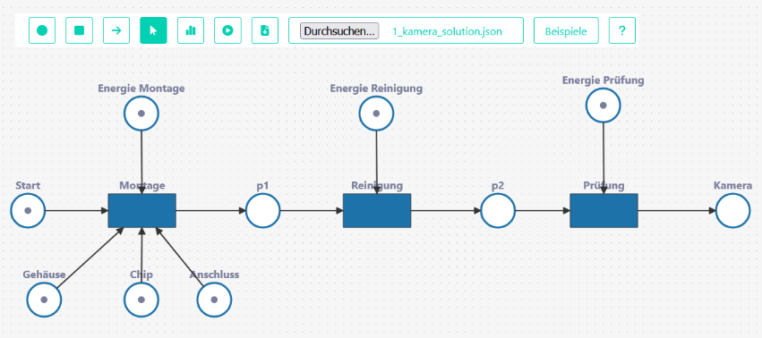
Related Approaches
Celonis
Material emissions app (procurement) ^{[5]}
Freight emissions app (logistics) ^{[6]}
PM for emission estimation & reduction
scope3tool ^{[7]}
Emissions from components in electronics manufacturing
Petri Net model: emission = consume token
Limitations
Process-specific
Closed source
Not object-centric
Fixed control flow
Image Source: A Fritsch et al.: Scope 3 Data in Electronics Supply Chains. 2023
[5] Celonis SE: Celonis’ New Material Emissions App Uses the Power of Process Intelligence to Simplify Scope 3 Reporting. 2023
[6] A Berzl: Building a product to reduce emissions with every process step. 2022
[7] A Fritsch et al.: Scope 3 Data in Electronics Supply Chains. 2023

Slide 15
Evaluation
● Order management
● Container logistics
● P2P
● Hinge manufacturing
Set emissions:
1 kg CO₂e per ev.
Label
HU / Res.
each object type
as target
each obj. Type
As targets
each obj. Type
As targets
OCEL
[9-12]
Best case:
ev. allocated to
exactly 1 object
Worst case:
ev. allocated to
all target objects
4 OCELs
×
6-10 Target object types
AllTargets
Measures
Number of events allocated to exactly 1 / all targets
Runtime
×
6 Allocation rules
ParticipatingTargets
ClosestTargets, full obj. interaction graph
180 Executions
= ?
ClosestTargets, full, w/o object type self-loops
✅
System
Ubuntu 24.04
Intel i7, 16 cores, 4.2-5.3 GHz
32GB DDR5-6000MHz CL36 RAM
ClosestTargets, HU interaction graph
= ?
ClosestTargets, HU, w/o object type self-loops

Slide 16
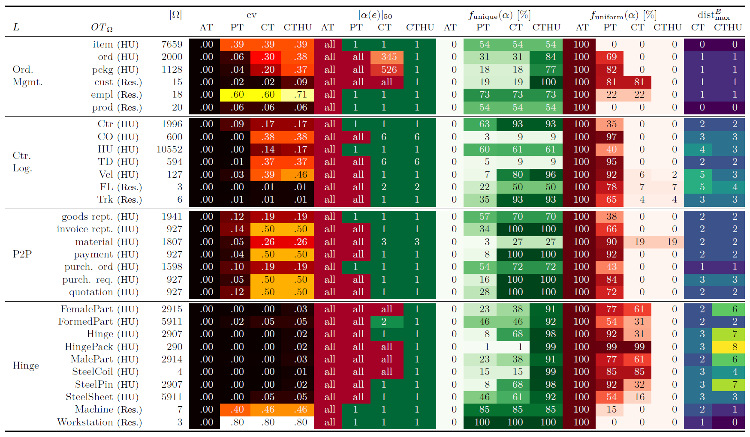
OCEL
Target
object type
#
targets
% Events allocated to …
max
distance
exactly 1 target
all targets
Notes:
Hinge – Hinge – AT < PT < CT < CTHU
CTHU: Alloc to all only in 4/30 ots!
Distances: Mostly low (especially OM)
Hinge greatest distances

Slide 17
HU Object Type Relations
Female part
● Hinge manufacturing
Steel coil
Steel sheet
Formed part
Steel pin
Hinge
Hinge pack
Male part
min. distance: 5
● Order management
order
item
package

Slide 18
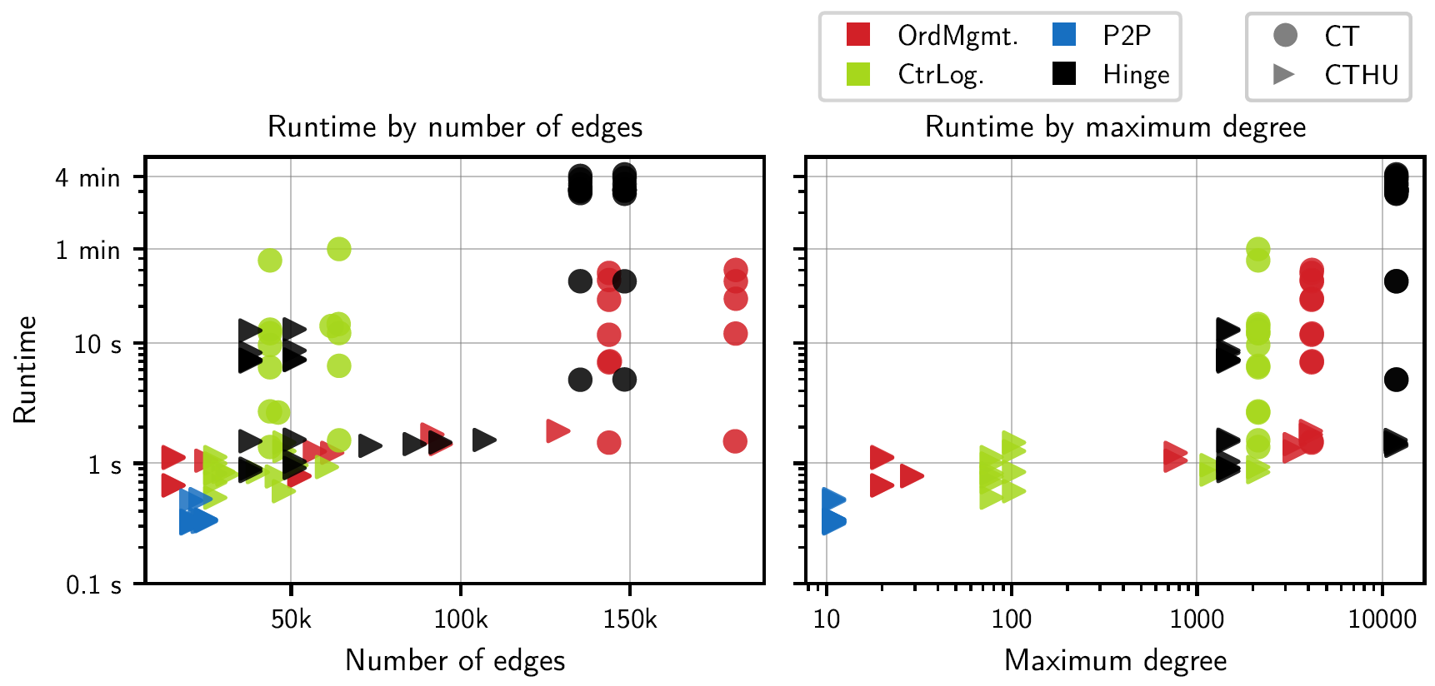
ClosestTargets – Runtime
Notes:
Runtime vs (left: numEdges, right: maxDegree)
Highest runtimes: Hinge manufacturing OCEL
Runtime correlates with numEdges and maxDegree
Runtime with HU interaction graph significantly less

Slide 19
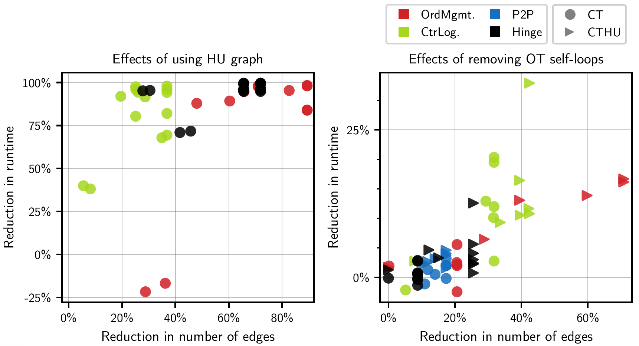
ClosestTargets – Runtime
Median: 2.4%
less runtime
Median: 96%
less runtime
(-77.8 s)

Slide 20
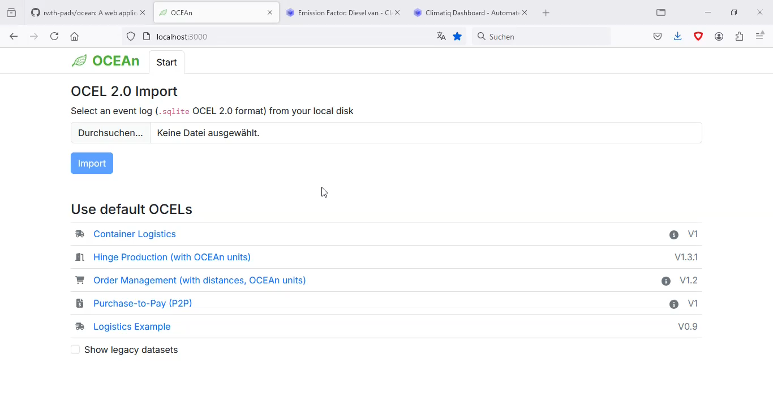

Slide 21
Conclusion
Enrich OCEL with emission data
Create multiple perspectives to process emissions
Use for carbon accounting and LCA
Limitations
Rely on user’s domain knowledge
No full carbon account – limited to event log
Future Work
Just adds emissions – apply PM on extended datasets
Interval discovery – time-based emissions
Automate HU/Resource detection
Combine multiple allocation rules
Weighted emission distribution

Slide 22
Additional Slides

Slide 23
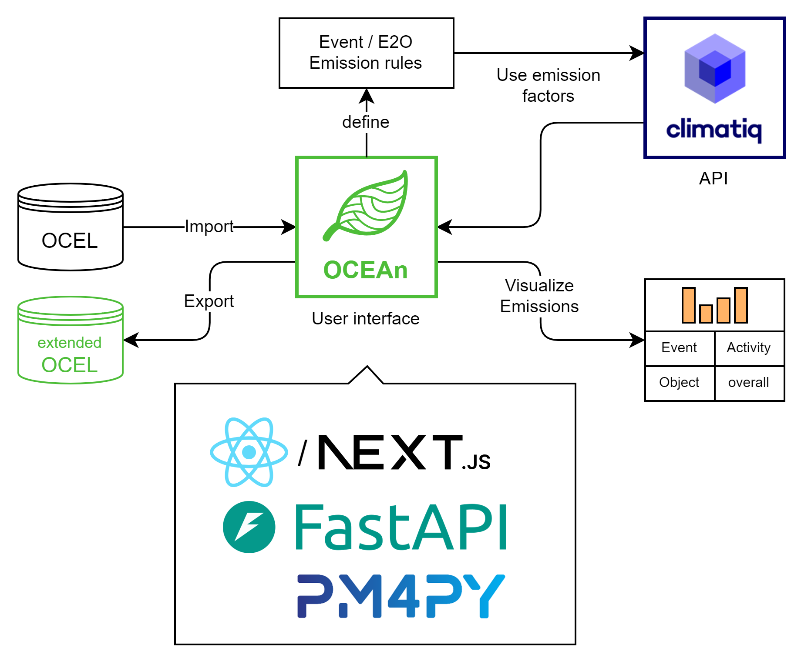
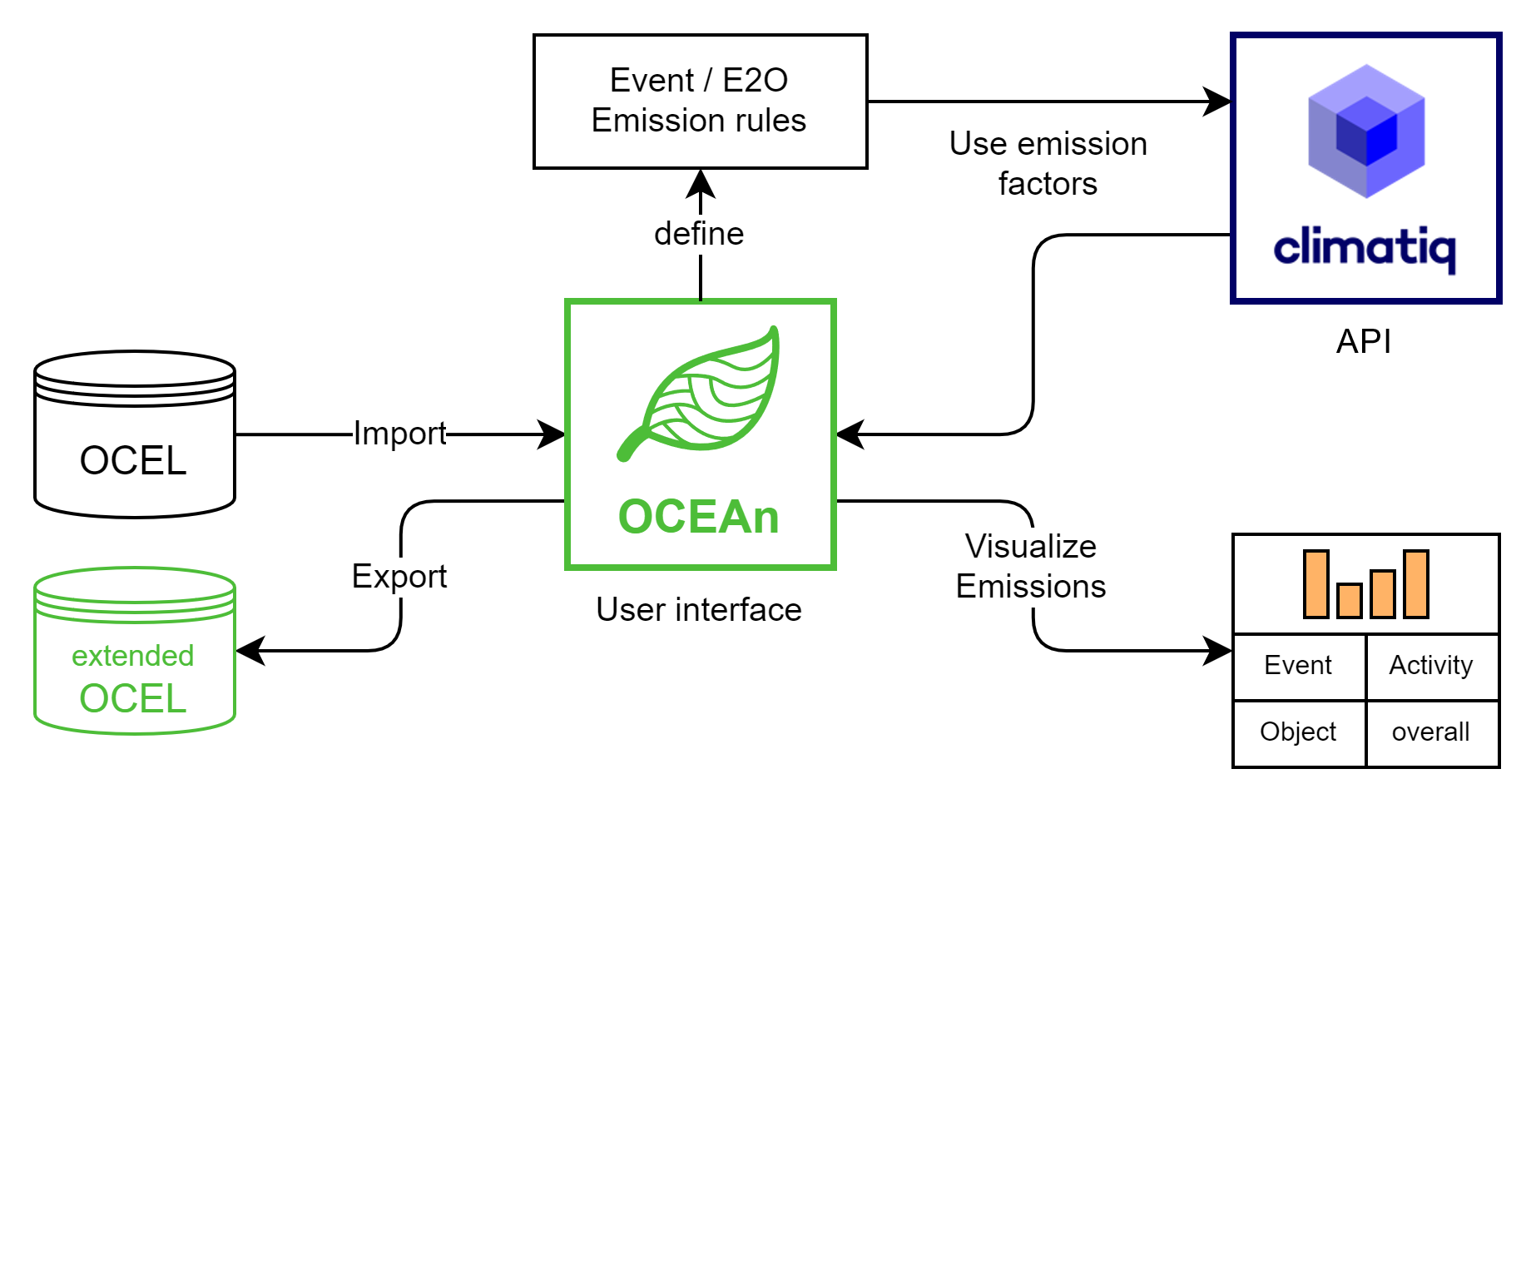
OCEAn – Architecture

Slide 24
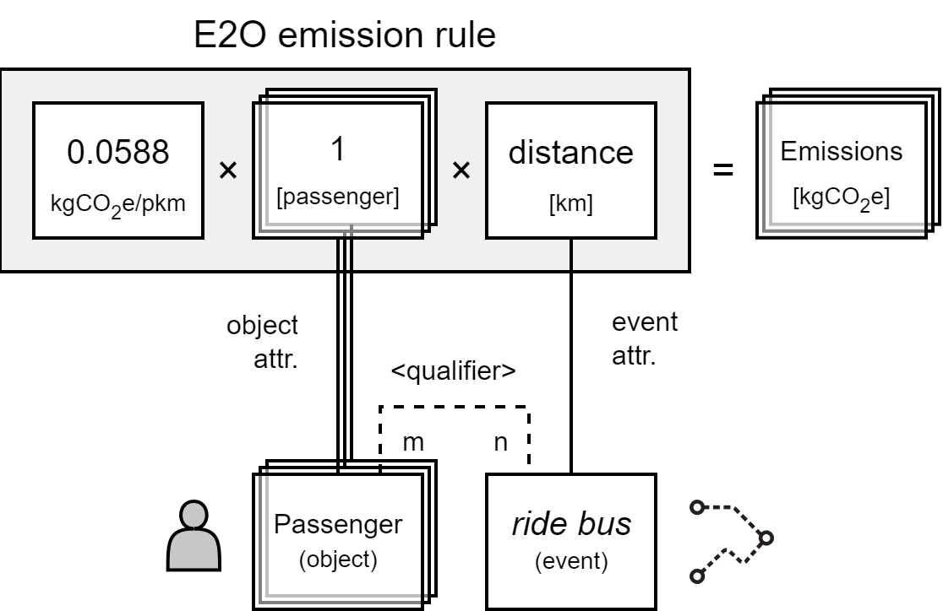
Emission Rules
Bus transportation – E2O-level
Activity: ride bus
Quantity of interest: pkm [#passengers * km]
Example OCEL:
#Passengers:
constant 1 per Passenger
Distance [km]:
event attr. of Transport
Multiply with emission factor
[65]
[65] “Emission intensity of diesel urban bus” – UBA (https://www.climatiq.io/data/emission-factor/06c42852-3f50-4f31-a86c-503d84b3eef5)

Slide 25
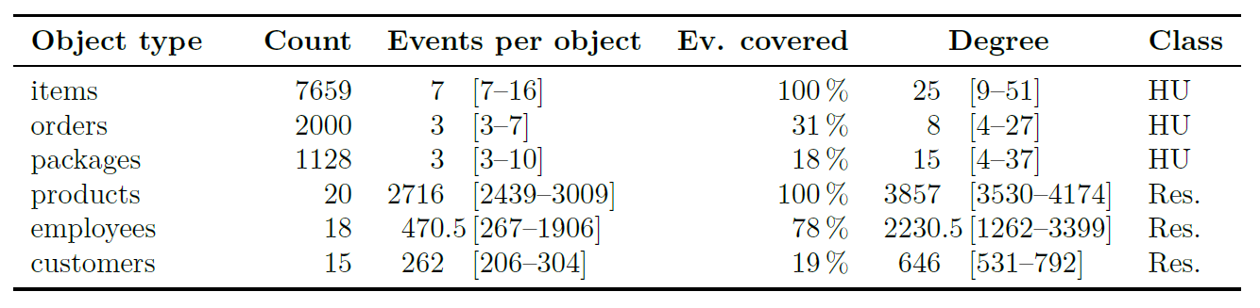
Object Types
● Order management

Slide 26
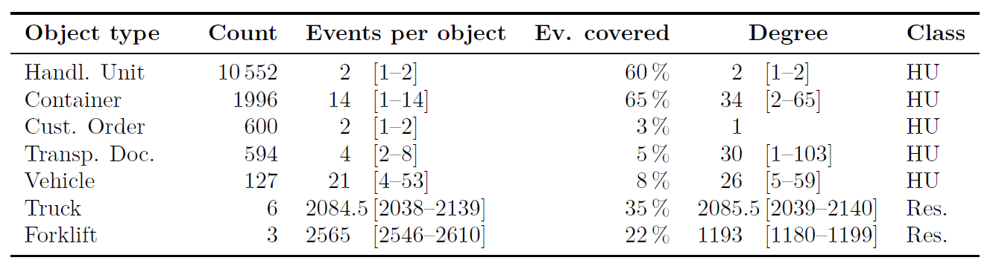
Object Types
● Container logistics

Slide 27
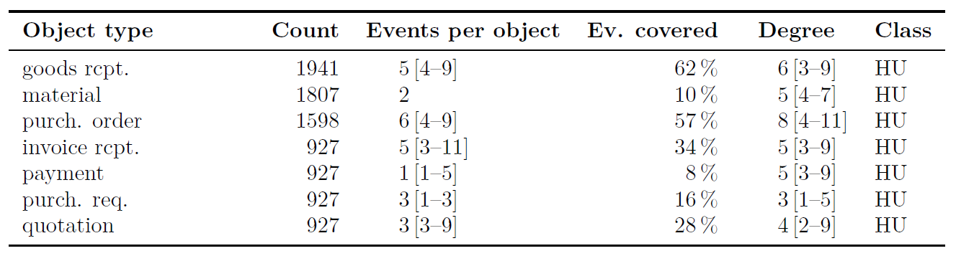
Object Types
● Procure-to-Pay (P2P)

Slide 28
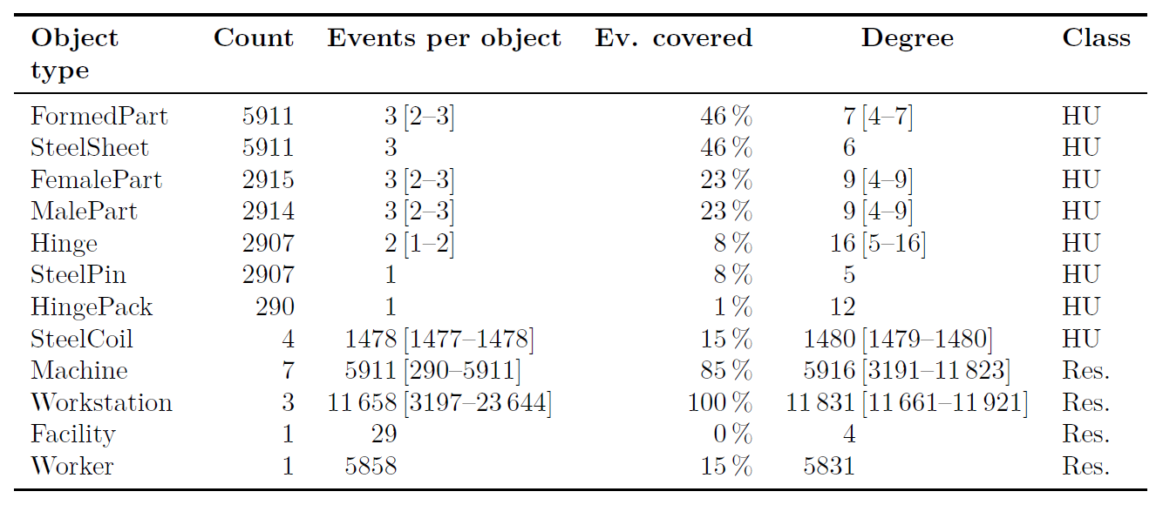
Object Types
● Hinge manufacturing

Slide 29
Extended OCEL – File export
Format
Separate .json file
Integration in .sqlite OCEL 2.0 file (extra table)
Including
Emission rules (reproducible results)
Object allocation config
Attribute units
Emission attributes
Object type classes (HU / resource)
Object type colors (consistent UX)
…

Slide 30
References
[1] L Brehm et al.: Process Mining for Carbon Accounting: An Analysis of Requirements and Potentials. 2022
[2] C Ortmeier et al.: Framework for the integration of Process Mining into Life Cycle Assessment. In: Procedia CIRP, 98:163-168, 2021
[3] N Graves et al.: ReThink Your Processes! A Review of Process Mining for Sustainability. In: ICT4S, pages 164-175, Rennes, France, 2023
[4] “Emission intensity of diesel (without biofuel content) per liter used in vehicle” – climatiq / GEMIS (https://www.climatiq.io/data/emission-factor/d56128ea-76e5-4a31-a6fe-b5e1ed855e52, accessed Oct 7th, 2024)
[5] Celonis SE: Celonis’ New Material Emissions App Uses the Power of Process Intelligence to Simplify Scope 3 Reporting. 2023
[6] A Berzl: Building a product to reduce emissions with every process step. 2022
[7] A Fritsch et al.: Scope 3 Data in Electronics Supply Chains. 2023
[8] A Berti et al.: OCEL (Object-Centric Event Logs) 2.0 Specification. 2023
Datasets:
[9] B Knopp, WMP van der Aalst: Order Management Object-centric Event Log in OCEL 2.0 Standard. 2023
[10] B Knopp et al.: Container Logistics Object-centric Event Log. 2023
[11] G Park, L Tacke genannt Unterberg: Procure-To-Payment (P2P) Object-centric Event Log in OCEL 2.0 Standard. 2023
[12] M Heinisch, N Graves: sOCEL 2.0. 2024

